Slide 1
Contents
Docker Compose
https://docs.docker.com/compose/

Slide 2
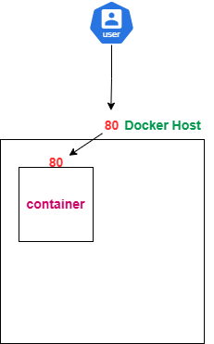
docker compose concepts (deploying One container application)

Slide 3
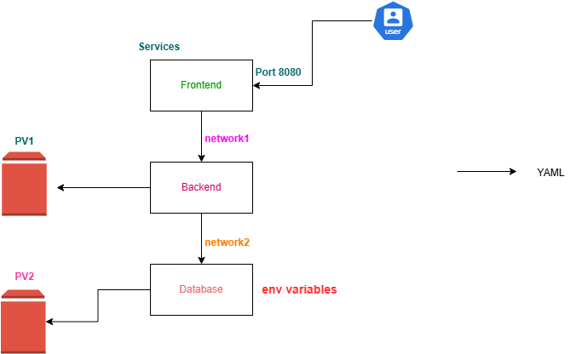
docker compose concepts (deploying Multi container application)

Slide 4
docker compose benefits
No need of manual “docker run” commands.
The application will have consistent behavior.
Automatic network creation for all services to communicate.
Handles dependencies automatically
Easier to scale

Slide 5
Docker Compose
Is a tool for defining and running multi-container applications
Simplifies the control of your entire application stack, making it easy to manage services, networks, volumes, and environment variables in a single, comprehensible YAML configuration file
Compose works in all environments; production, staging, development, testing, as well as CI workflows

Slide 6
How compose works?
A single YAML (YAML Ain't Markup Language) file called compose file (compose.yaml) that consists of:
Docker containers (services)
Networks
Volumes
Key commands
To start all the services defined in your compose.yaml file:
docker compose up
To stop and remove the running services:
docker compose down
If you want to monitor the output of your running containers and debug issues, you can view the logs with:
docker compose logs
To lists all the services along with their current status:
docker compose ps
https://docs.docker.com/reference/cli/docker/compose/

Slide 7
docker compose installation
https://docs.docker.com/compose/install/standalone/
curl -SL https://github.com/docker/compose/releases/download/v2.33.1/docker-compose-linux-x86_64 -o /usr/local/bin/docker-compose
chmod +x /usr/local/bin/docker-compose
docker-compose

Slide 8
Docker compose sample projects
https://github.com/docker/awesome-compose.git
git clone https://github.com/docker/awesome-compose.git

